Slide 1
SCITDA 2018 Spring Leadership Conference
Doug Kim
doug@dougkim.com
864-616-9095
March 4th, 2018 to March 6th, 2018
Charleston Marriott

Slide 2
Today’s Topics
Cyber Security –What We Can Learn From Litigation Theories
Open Source – Attempts To Shift Liability
Open Source – GPL2 vs. GPL3
Trends in Trademark Litigation in South Carolina (time permitting)

Slide 3
Cyber Security –What We Can Learn From Litigation Theories

Slide 4
Notable 2017 - Data Breach
University of Oklahoma (June 14, 2017)
University’s document sharing system (Delve) compromised resulting in educational records, dating back to at least 2002 unintentionally exposed through incorrect privacy settings.
Sensitive information included SSN, financial aid information, and grades.
29,000 instances.
Identity Force

Slide 5
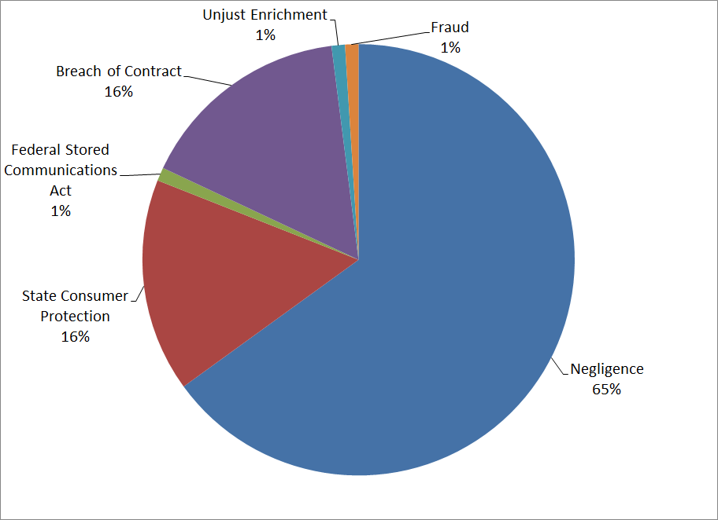
Primary Legal Theory
Notes:
Federal Stored Communications Act -

Slide 6
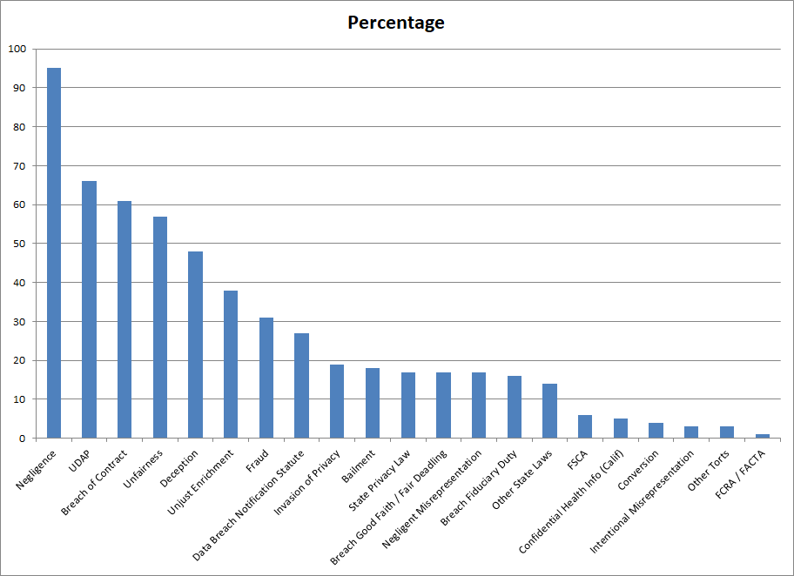
Legal Theories Asserted
Notes:
Unfair and deceptive practices” prongs of Section 5 of the FTC Act (15 U.S.C. §45). Section 5(a) of the FTC Act prohibits unfair or deceptive acts or practices (UDAP)
FCRA – Fair Credit Reporting Act

Slide 7
Negligence (SC)
(1) The Defendant owes a duty of care;
(2) The Defendant breached that duty of care;
(3) The Defendant's breach proximately caused damage.
Plaintiff may only recover for injuries proximately caused by the Defendant's negligence.
See Bishop v. South Carolina Dep't of Mental Health, 331 S.C. 79, 502 S.E.2d 78 (1998); Jeffords v. Lesesne, 343 S.C. 656, 541 S.E.2d 847 (Ct. App. 2000); Hubbard v. Taylor, 339 S.C. 582, 529 S.E.2d 549 (Ct. App. 2000). Olson v. Faculty House, 344 S.C. 194, 544 S.E.2d 38 (Ct. App. 2001).

Slide 8
DUTY OF CARE

Slide 9
Duty of Care
Keeper Security / Ponemon Institute of the 1,000 IT professionals surveyed, 54% said careless workers were the root cause of cybersecurity incidents.
Higher Turn Over / Higher Risks
Smart Phone, Tablet, can access data
Poor company password policies second root cause of cybersecurity incidents.

Slide 10
Duty of Care – US Dept. Education
The Department of Education’s Privacy Program
“The Department of Education is committed and dedicated to protecting the privacy rights of students, teachers, and administrators in schools around the country.

Slide 11
Duty of Care – US Dept. Education
Privacy at ED Office of the Chief Privacy Officer
The Office of the Chief Privacy Officer (OCPO) provides leadership, oversight, and coordination to ensure Departmental compliance with government initiatives regarding the acquisition, release and maintenance of information. In particular, OCPO oversees the administration of the following federal statutes at the Department of Education (ED) (emphasis added)

Slide 12
Duty of Care – SC Consumer Protection
The Family Privacy Protection Act
SECTION 30-2-20. Privacy policies and procedures required of all state entities. All state agencies, boards, commissions, institutions, departments, and other state entities, by whatever name known, must develop privacy policies and procedures to ensure that the collection of personal information pertaining to citizens of the State is limited to such personal information required by any such agency, board, commission, institution, department, or other state entity and necessary to fulfill a legitimate public purpose.

Slide 13
Duty of Care – SC Consumer Protection
The Family Privacy Protection Act
SECTION 30-2-40. Display of privacy policy on web site; access to personal information disclosure; criminal justice and judicial agency exception. (A) Any state agency, board, commission, institution, department, or other state entity which hosts, supports, or provides a link to page or site accessible through the world wide web must clearly display its privacy policy and the name and telephone number of the agency, board, commission, institution, department, or other state entity person responsible for administration of the policy.

Slide 14
BREACH OF THE DUTY OF CARE

Slide 15
DID UO Breach Its Duty?
University of Oklahoma (June 14, 2017)
University’s document sharing system (Delve) compromised resulting in educational records, dating back to at least 2002 unintentionally exposed through incorrect privacy settings.
Sensitive information included SSN, financial aid information, and grades.
29,000 instances
What Is Its Duty?
Did It Breach Its Duty?

Slide 16
Notable 2017 - Data Breaches
Washington States University (June 15, 2017)
A hard drive containing the personal information of approximately one million individuals was stolen from a storage unit in Olympia, WA.
The hard drive was inside an 85-pound safe and the safe was actually stolen.
Social Security numbers and health history were among the personal details stolen.
What Is Its Duty?
Did It Breach Its Duty?
Identity Force

Slide 17
Jason Shore v. Johnson & Bell
Class Action Complaint
“to put an end to Defendant's practice of systematically exposing confidential client information and storing client data without adequate security”
Defendant has “several computer systems that allow clients and employees to connect remotely to internal servers, access and transmit emails, and manage and record detailed time records”

Slide 18
Jason Shore v. Johnson & Bell
Class Action Complaint
“Johnson & Bell has injured its clients by charging and collecting market-rate attorneys' fees without providing industry standard protections for client confidentiality”
“hackers can breach its system with impunity because Defendant has improperly configured the service and left it running out-of-date software”

Slide 19
Jason Shore v. Johnson & Bell
Class Action Complaint
“Defendant's JBoss system is listed as running version 4.0.2.
A review of industry literature reveals that that version of JBoss was introduced in 2005 and is ‘End of Life,’ or, no longer supported or recommended for use”
What Is Its Duty?
Did It Breach Its Duty?

Slide 20
THE BREACH PROXIMATELY CAUSED THE DAMAGE

Slide 21
Causation – In Fact and Legal
Causation In Fact
The injury would not have occurred "but for" the defendant's negligence.
Legal Causation - Foreseeability.
An injury is foreseeable if it is the natural and probable consequence of a breach of duty.
Foreseeability is not determined from hindsight, but rather from the defendant's perspective at the time of the alleged breach.

Slide 22
Notable 2017 - Data Breaches
University of Oklahoma (June 14, 2017)
University’s document sharing system (Delve) compromised resulting in educational records, dating back to at least 2002 unintentionally exposed through incorrect privacy settings.
Sensitive information included SSN, financial aid information, and grades.
29,000 instances.
Did the Breach Cause Damages?
Is release of data enough for damages?
Is the costs of credit monitoring damages?

Slide 23
Notable 2017 - Data Breaches
Washington States University (June 15, 2017)
A hard drive containing the personal information of approximately one million individuals was stolen from a storage unit in Olympia, WA.
The hard drive was inside an 85-pound safe and the safe was actually stolen.
Social Security numbers and health history were among the personal details stolen.
Did the Breach Cause Damages?
Is release of data enough for damages?
Is the costs of credit monitoring damages?

Slide 24
Jason Shore v. Johnson & Bell
Class Action Complaint
“Johnson & Bell has injured its clients by charging and collecting market-rate attorneys' fees without providing industry standard protections for client confidentiality”
Damages ?

Slide 25
Review Everything in in light of “Negligence”
(1) The Defendant owes a duty of care;
(2) The Defendant breached that duty of care;
(3) The Defendant's breach proximately caused damage.
Plaintiff may only recover for injuries proximately caused by the Defendant's negligence.
See Bishop v. South Carolina Dep't of Mental Health, 331 S.C. 79, 502 S.E.2d 78 (1998); Jeffords v. Lesesne, 343 S.C. 656, 541 S.E.2d 847 (Ct. App. 2000); Hubbard v. Taylor, 339 S.C. 582, 529 S.E.2d 549 (Ct. App. 2000). Olson v. Faculty House, 344 S.C. 194, 544 S.E.2d 38 (Ct. App. 2001).

Slide 26
Legal Theories Asserted

Slide 27
Open Source – Attempts To Shift Liability

Slide 28
Open Source – Areas of Risk
Upstream IP concerns:
Potential risk that “open source” code is actually proprietary and requires a license fee because an unknown piece of proprietary code leaked into the final the product.
© and licensing issues
Viral Software – Mandatory Release of Source
The unintended inclusion of open source could cause an organization to losing control over some exclusive competitive advantage as it becomes required to release internal software source code.

Slide 29
Open Source – Areas of Risk
Lack of Traditional Warranties and Indemnifications
Lacks standard warranties and IP indemnity can lead to customer liability against third party legal claims. When open source is provided “AS IS” the risk is on the customer and not the vendor.

Slide 30
Apache License ver. 2.0
"Work" shall mean the work of authorship, whether in Source or Object form, made available under the License, as indicated by a copyright notice that is included in or attached to the work (an example is provided in the Appendix below).
7. Disclaimer of Warranty.
Unless required by applicable law or agreed to in writing, Licensor provides the Work (and each Contributor provides its Contributions) on an "AS IS" BASIS, WITHOUT WARRANTIES OR CONDITIONS OF ANY KIND, either express or implied, including, without limitation, any warranties or conditions of TITLE, NON-INFRINGEMENT, MERCHANTABILITY, or FITNESS FOR A PARTICULAR PURPOSE. You are solely responsible for determining the appropriateness of using or redistributing the Work and assume any risks associated with Your exercise of permissions under this License.

Slide 31
Apache License ver. 2.0
"Contributor" shall mean Licensor and any individual or Legal Entity on behalf of whom a Contribution (e.g. any work of authorship, original or modifications) has been received by Licensor and subsequently incorporated within the Work.
8. Limitation of Liability.
In no event and under no legal theory, whether in tort (including negligence), contract, or otherwise, unless required by applicable law (such as deliberate and grossly negligent acts) or agreed to in writing, shall any Contributor be liable to You for damages, including any direct, indirect, special, incidental, or consequential damages of any character arising as a result of this License or out of the use or inability to use the Work (including but not limited to damages for loss of goodwill, work stoppage, computer failure or malfunction, or any and all other commercial damages or losses), even if such Contributor has been advised of the possibility of such damages.

Slide 32
Apache License ver. 2.0
"9. Accepting Warranty or Additional Liability.
While redistributing the Work or Derivative Works thereof, You may choose to offer, and charge a fee for, acceptance of support, warranty, indemnity, or other liability obligations and/or rights consistent with this License. However, in accepting such obligations, You may act only on Your own behalf and on Your sole responsibility, not on behalf of any other Contributor, and only if You agree to indemnify, defend, and hold each Contributor harmless for any liability incurred by, or claims asserted against, such Contributor by reason of your accepting any such warranty or additional liability.
Will a Vendor Agree to this?

Slide 33
Apache License ver. 2.0
Contributor(s)
Vendor
Customer

Slide 34
Apache License ver. 2.0
Copyright [yyyy] [name of copyright owner]
Licensed under the Apache License, Version 2.0 (the "License"); you may not use this file except in compliance with the License. You may obtain a copy of the License at
http://www.apache.org/licenses/LICENSE-2.0
Unless required by applicable law or agreed to in writing, software distributed under the License is distributed on an "AS IS" BASIS, WITHOUT WARRANTIES OR CONDITIONS OF ANY KIND, either express or implied. See the License for the specific language governing permissions and limitations under the License.

Slide 35
Potential “Outside” Agreement to the Apache License ver. 2.0
The software provided by the Vendor includes open source that is subject to the Apache License, Version 2.0 (“Apache License”). The parties wish to amend the Apache License as follows:
In the event that there is a conflict between this Agreement and the Apache License, this Agreement controls.

Slide 36
Open Source GPL2 vs. GPL3

Slide 37
GPL 2 - 1991
4. You may not copy, modify, sublicense, or distribute the Program except as expressly provided under this License. Any attempt otherwise to copy, modify, sublicense or distribute the Program is void, and will automatically terminate your rights under this License. However, parties who have received copies, or rights, from you under this License will not have their licenses terminated so long as such parties remain in full compliance.

Slide 38
GPL 3 - 2007
8. Termination.
You may not propagate or modify a covered work except as expressly provided under this License. Any attempt otherwise to propagate or modify it is void, and will automatically terminate your rights under this License (including any patent licenses granted under the third paragraph of section 11).
However, if you cease all violation of this License, then your license from a particular copyright holder is reinstated (a) provisionally, unless and until the copyright holder explicitly and finally terminates your license, and (b) permanently, if the copyright holder fails to notify you of the violation by some reasonable means prior to 60 days after the cessation.
Moreover, your license from a particular copyright holder is reinstated permanently if the copyright holder notifies you of the violation by some reasonable means, this is the first time you have received notice of violation of this License (for any work) from that copyright holder, and you cure the violation prior to 30 days after your receipt of the notice.

Slide 39
Trademark Trends in South Carolina

Slide 40
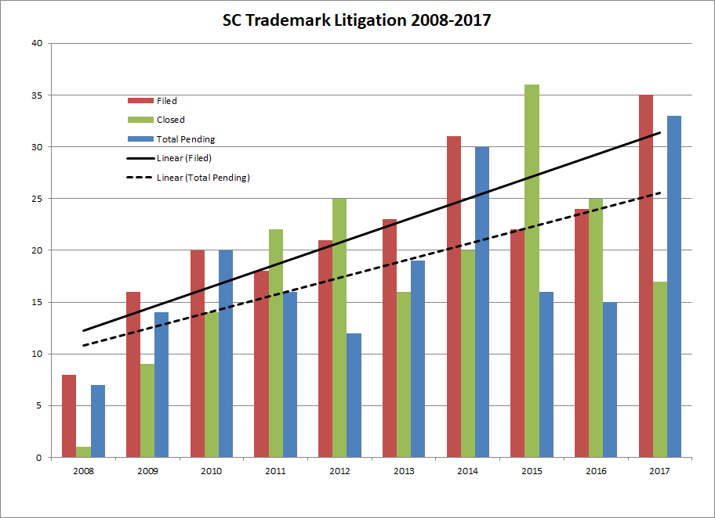

Slide 41
Reducing These Risks
Perform a federal trademark search.
Understand the relationship with trademarks and your business relationship.
10% percent of the 2017 cases overlap with “business” issues
Understand the geographic issue with trademark rights.
Select a strong mark.
Consult with a knowledgeable and trustworthy trademark attorney.

Slide 42
THANK YOU
Doug Kim
doug@dougkim.com
864-616-9095

